Slide 1





KAVACH
FUTURISTIC FLEXIBLE ELECTRONICS-BASED COMMUNICATION SYSTEM FOR MONITORING SOLDIER'S CONDITION DURING WARFARE
Nisarg Jadav
DA-IICT, GANDHINAGAR

Slide 2

Brief description of the system​
Effective communication is crucial for military operations, particularly in remote areas or locations with no mobile or cellular network (in absence of 2G/3G/4G/5G/Internet). We have developed a hardware (a phone like device) that can establish long range communication (around 25 km) between soldiers and a base station.
The hardware uses state of art MPU and sensors configuration designed for low power consumption. The system includes repeaters, which are designed to extend the range of communication specially in uneven terrain.
Text, image and GPS location of every solder are securely transmitted between each other and the base station. The GPS sensor utilizes the Indian Regional Navigation Satellite System (IRNSS) for precise positioning.
A touchscreen interface with a GUI is used to control the operation of the system and display the data sent and received. In addition to text and image, position of every soldier can be displayed on a screen at the base station in an offline mode.
We have tested the system as mentioned above at our end. But this needs to be further tested in the real condition. After our visit to the military site Udhampur, we will know exactly its performance specially with respect to distance and time taken for the communication. Based on the inputs then, further changes can be incorporated.

Slide 3
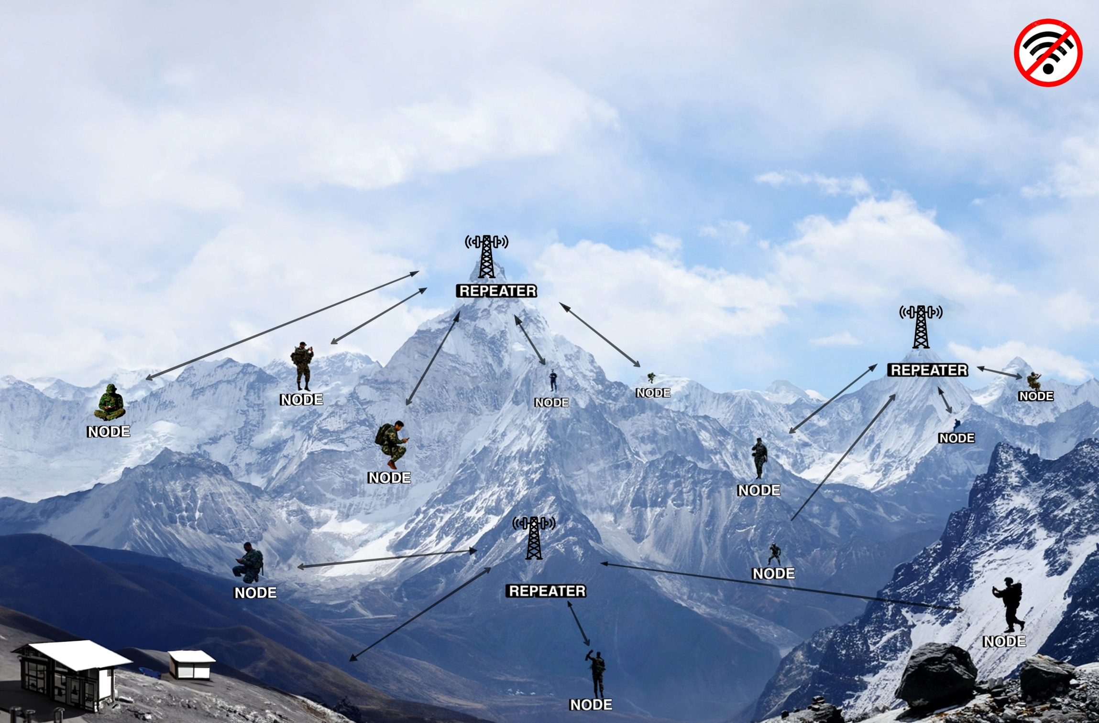
Objective​
Aim : Long distance Communication (around 25 km) between
soldiers and base station in absence of cellular network.​
​
CONTROL ROOM

Slide 4

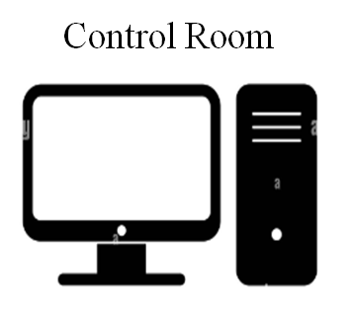
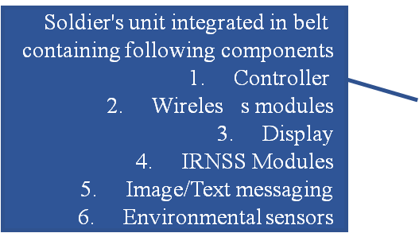
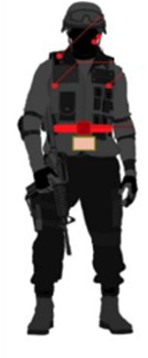
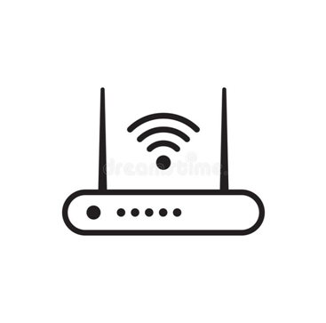


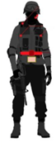
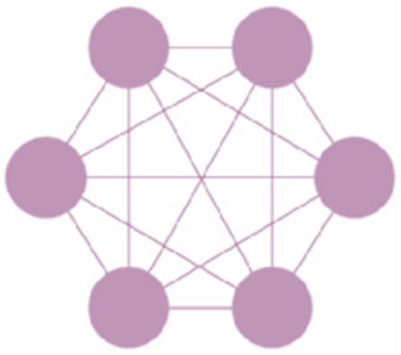
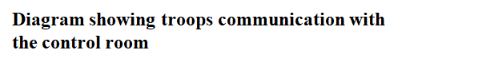

Methodology
Soldier Mesh Network
Repeater

Slide 5
Methodology
The method involves a mesh network of user electronic devices in an area without cellular coverage. These devices communicate via a LoRa module and relay information through repeaters to a central control system.
The first user device receives user input and sensor data, creating and encrypting a message based on this information, which it then transmits to the repeaters.
The repeater amplifies the received message and forwards it to the control system or the other user devices.
The central control system decrypts and displays the received message in a graphical user interface (GUI).
The second user device receives and decrypts the message, processes it according to its data type (e.g., converting audio data into text or displaying image/text data).

Slide 6
Methodology
The first user device also gathers various sensor data, including GPS location, image information, altitude, humidity, motion, and audio.
Transmission of encrypted messages from the first device considers the data type, which could be segmented image data, converted audio data into text, or direct transmission of text data.
When image data is involved, both the central control system and second user device have mechanisms to ensure complete data reception by sending acknowledgment messages and requesting retransmission for missing data chunks.
User inputs are received by each device through a GUI, displayed either on an embedded display in the device or a secondary associated display.
The system is comprised of several user electronic devices, repeaters, and a central control system. Each component is configured to fulfil specific roles and functionalities as outlined in the method.

Slide 7
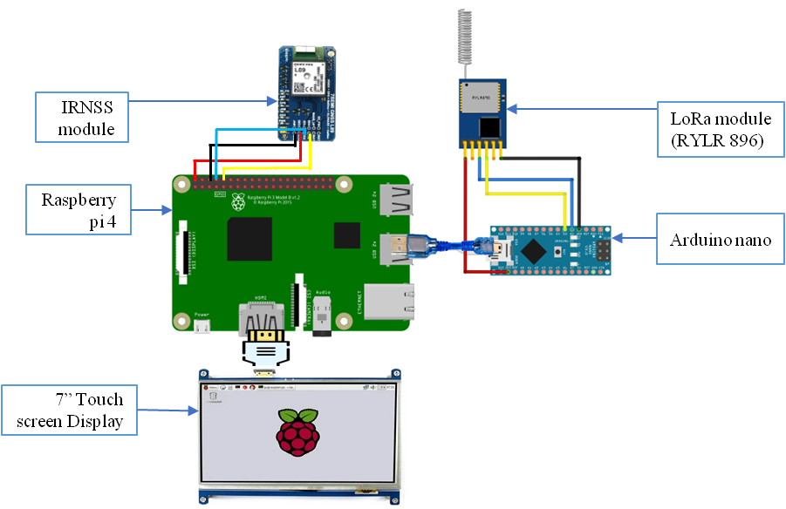
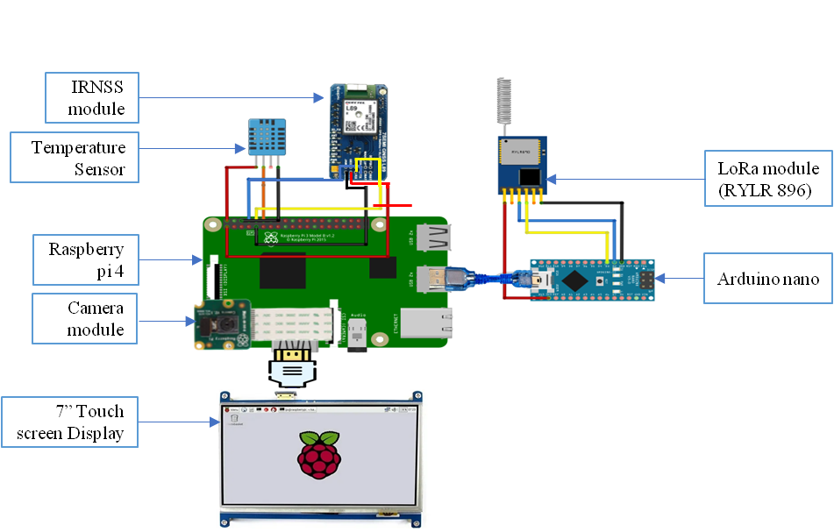
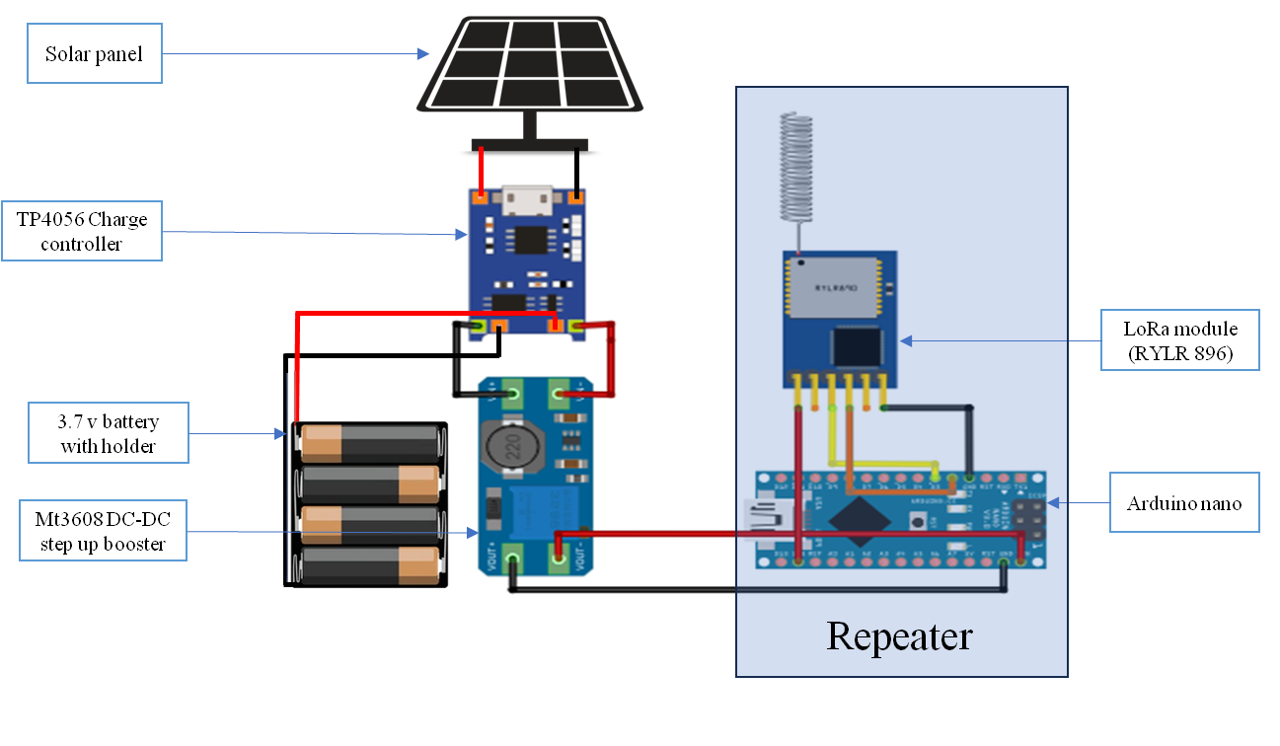
Hardware and Software
RECIEVER CIRCUIT
SENDER CIRCUIT
REPEATER CIRCUIT

Slide 8
Achieved (Chat box)
Our device is capable of bidirectional communication, acting as both the sender and receiver in a chat conversation
These messages are then encrypted using the Caesar cipher encryption algorithm. , the receiver decrypts it using the same Caesar cipher algorithm and displays it in the graphical user interface (GUI) chat window

Slide 9

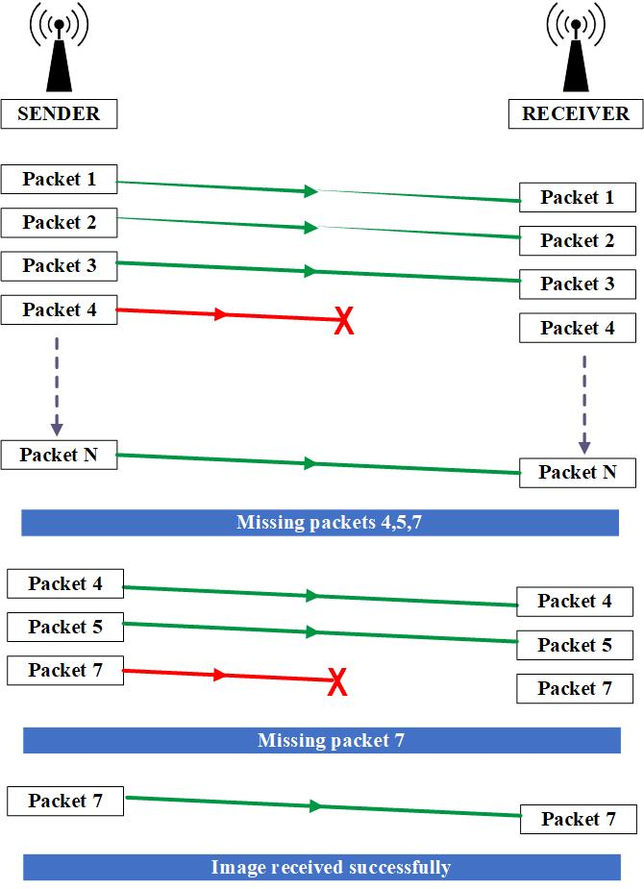
Achieved( Image transmission )
Sender initiates the file transfer by sending a control signal to the receiver via the serial port. It then sends the number of chunks required for the file transmission. Each chunk, along with a unique identifier and header, is sent individually to the receiver.
The receiver acknowledges the successful reception of each chunk. After transmitting all the chunks, the sender waits briefly and sends a control signal to indicate the end of the transmission. The receiver responds with a string listing any missing chunks.

Slide 10
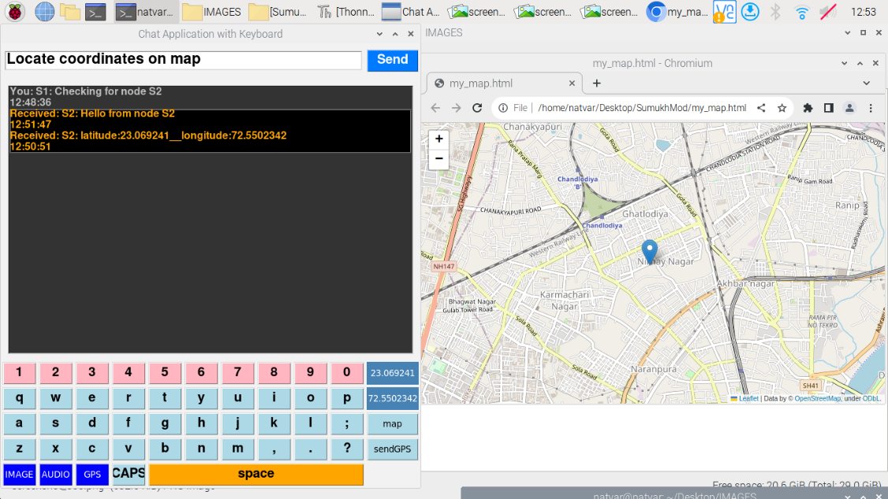

Achieved
GPS Location ​
The process of displaying GPS(IRNSS) data involves the Raspberry Pi receiving the data from the GPS module, parsing it, and displaying it on the GUI. ​
The GPS sensor utilizes the Indian Regional Navigation Satellite System (IRNSS) for precise positioning. The LoRa module, touchscreen interface, camera, temperature sensor, GPS sensor, and altitude sensor are integrated into a single node provided to each soldier.​

Slide 11
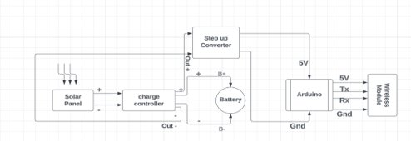
Achieved
Solar Powered Repeater ​
To further improve the sustainability and reliability of our system, we have implemented solar-powered repeaters. These repeaters are powered by solar panels, , making them an excellent solution for remote locations where access to traditional power sources may be limited or non-existent.​

Slide 12


Publication / Patent​
We have successfully filed a patent for our invention, filing a patent application initiates a review process by the relevant patent office.
Once the patent is granted and published, we can proceed with the publication of our paper.

Slide 13
THANK YOU
For watching this presentation

